Slide 1
Autonomous Probe Card Analysis
Progress Report
Name: Chih-Kwang Li 李志洸
Contact: linicky1021@gmail.com
0972498002
Advisor: Chiou-Shann Fuh 傅楸善
Date: 2020/08/06
Notes:
探針卡的自動化檢查

Slide 2
Outline
Introduction
Motivation
Objective
Methods
Progress reports
Future goals

Slide 3
Introduction
Wafer
Probe Card Testing Introduction
Probe Card

Slide 4
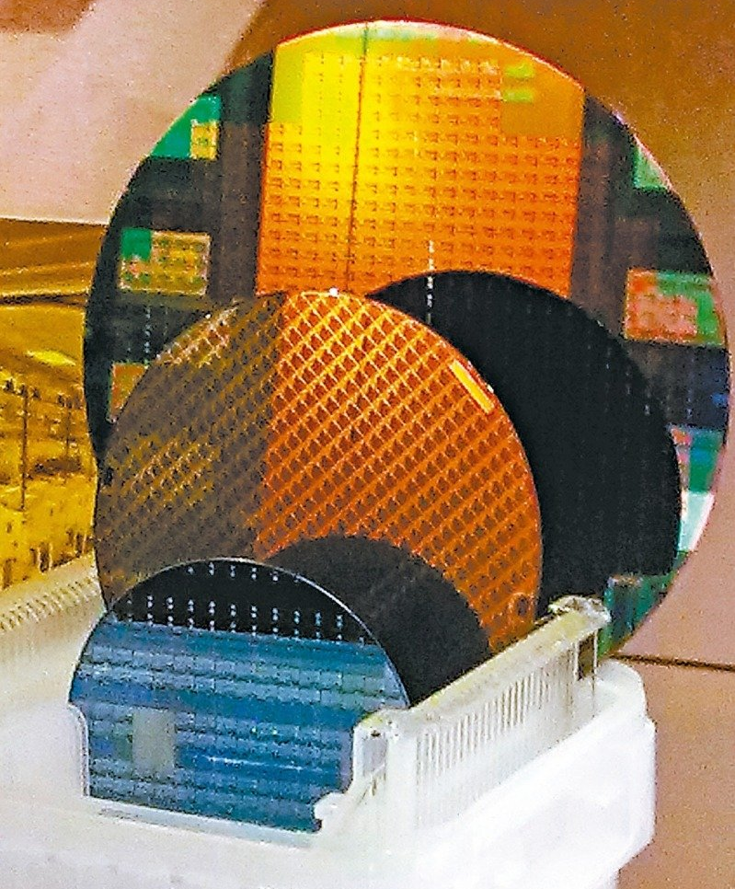
Wafer
Circular silicon disk used to manufacure silicon integrated circuits.

Slide 5
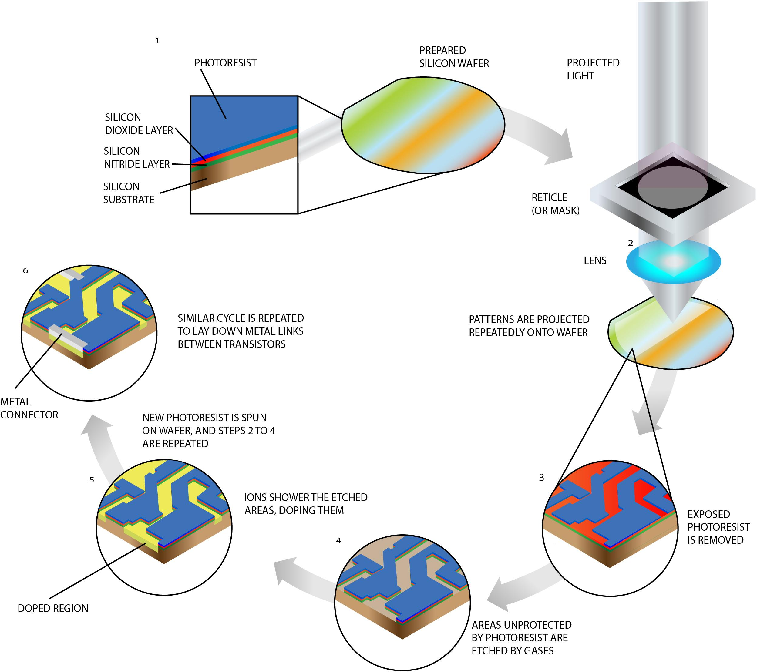
Wafer
Manufacture Process
Notes:
蝕刻法 電路 對外界的接觸點

Slide 6
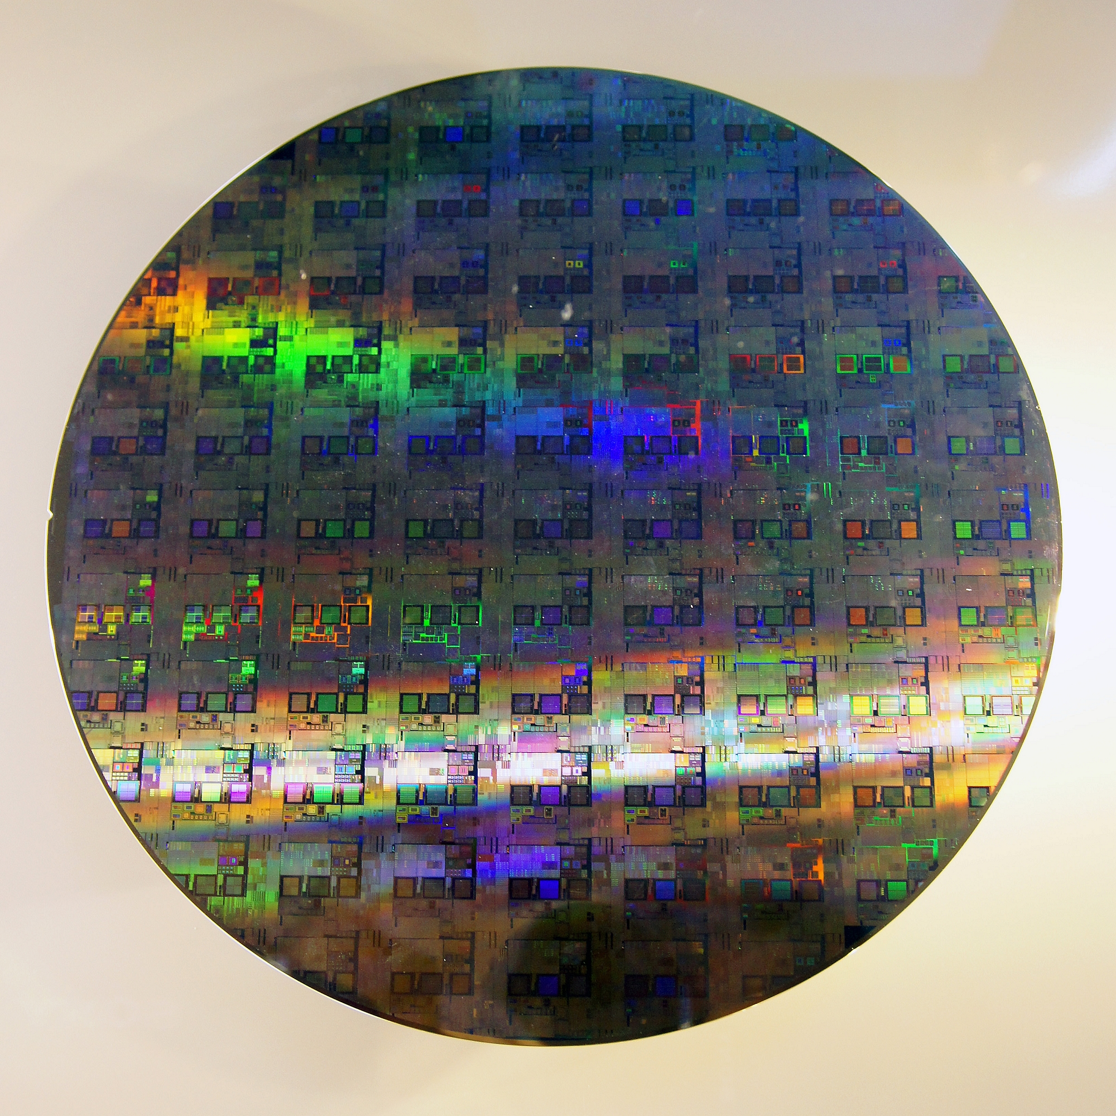
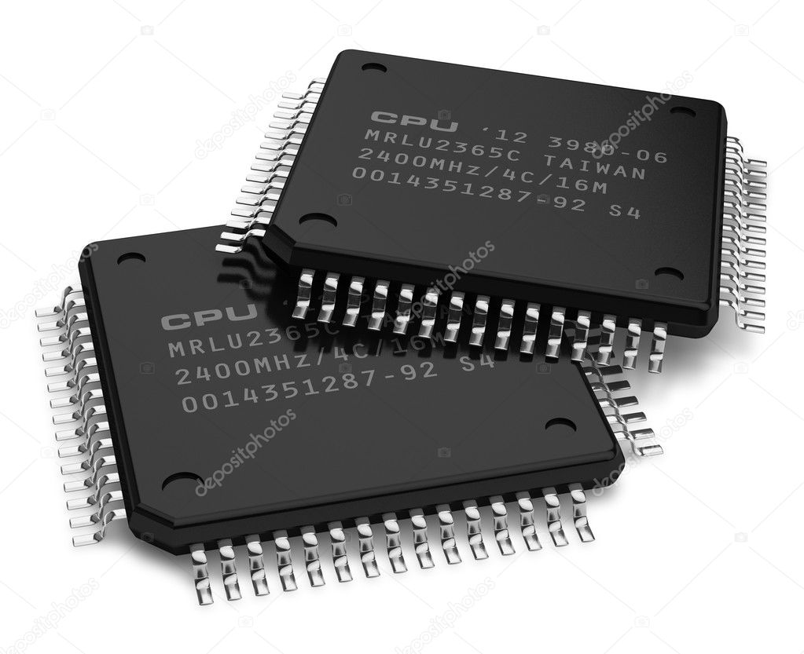
Wafer晶圓, Die晶粒 and Chip晶片

Slide 7
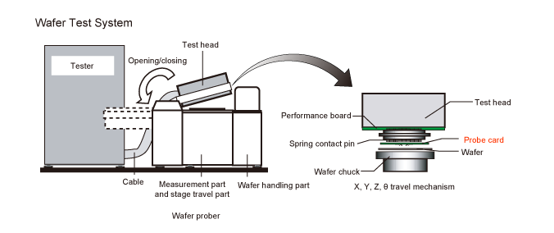
Probe Card Testing Introduction
Notes:
這是一張簡易示意圖
在一個無塵的環境中來操作

Slide 8
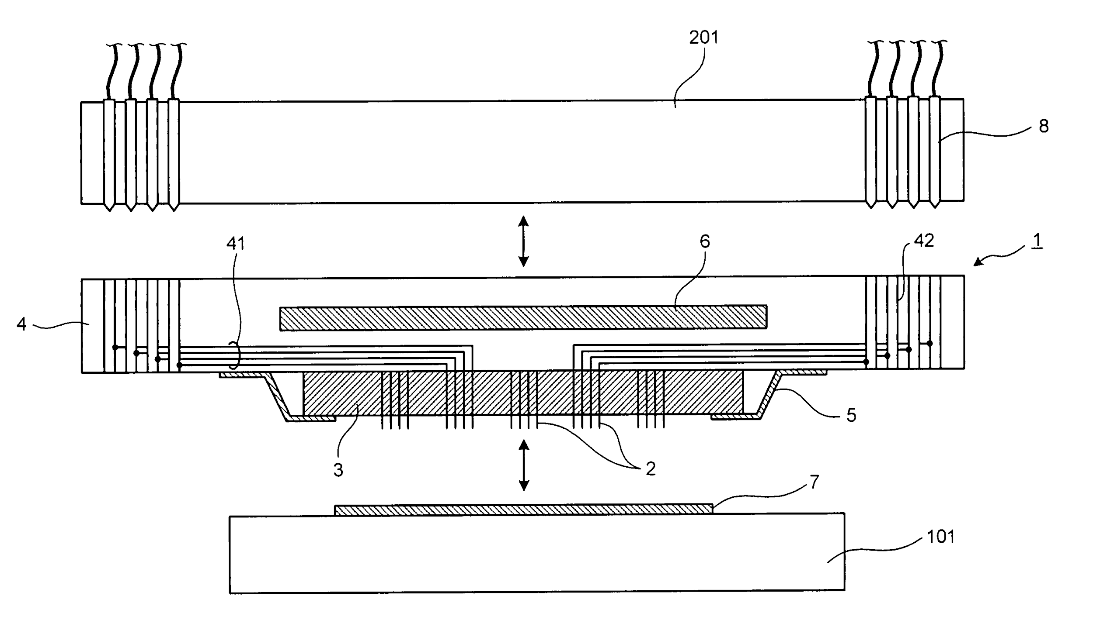

Slide 9
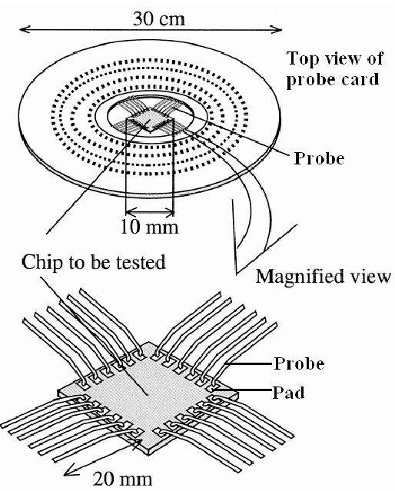

Slide 11
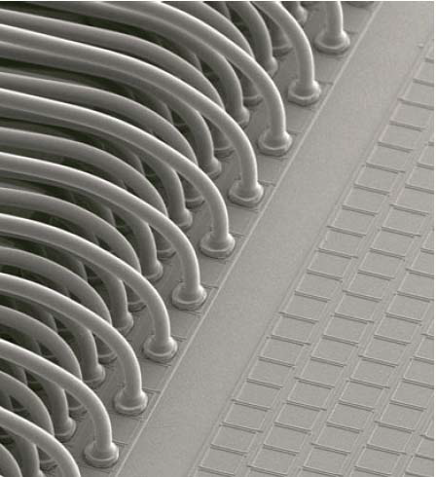
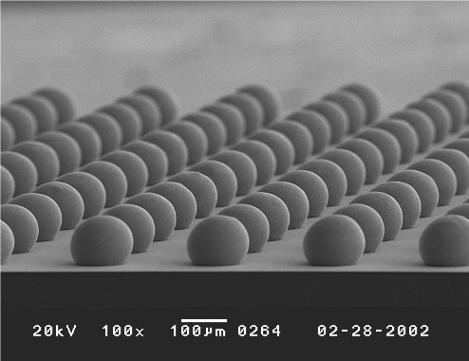
Pads (Al, Cu) and Bumps (Sn, Pb)

Slide 13
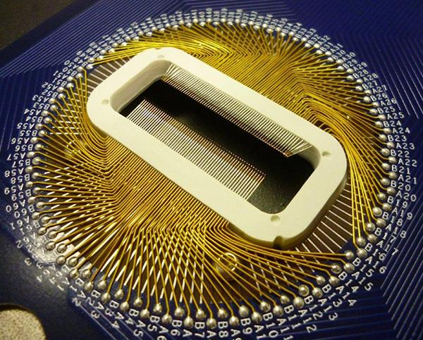
Porbe Card
Probe card is used for detecting flaws in a integreted circuit input/output pads.

Slide 14
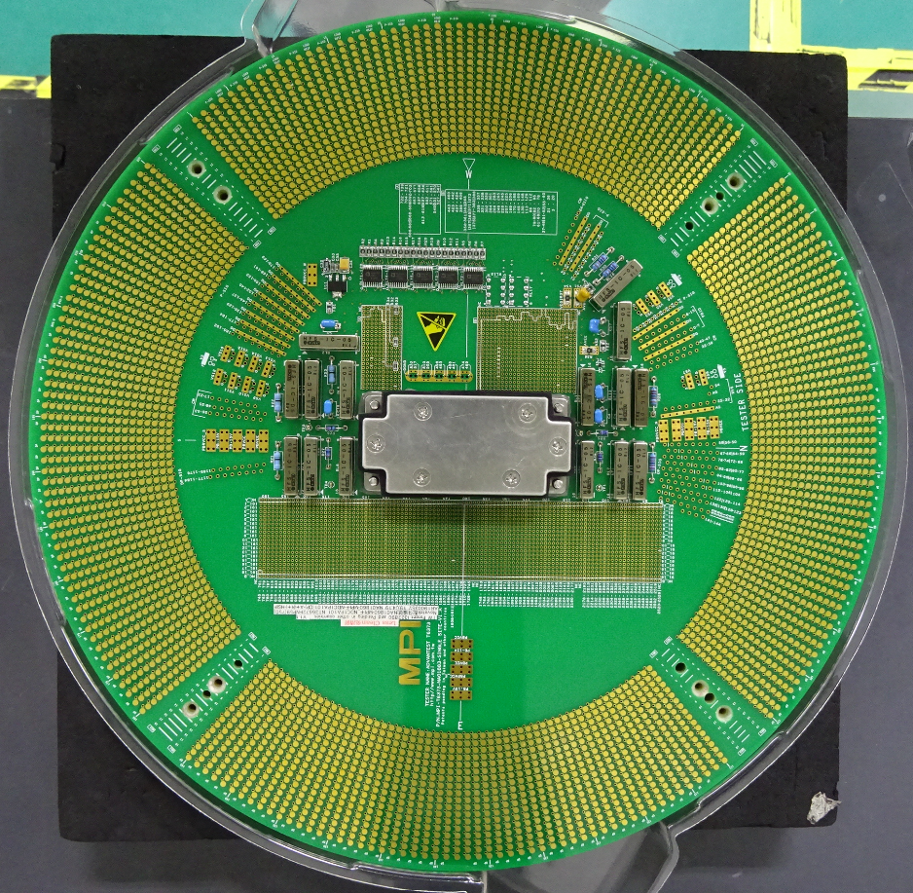
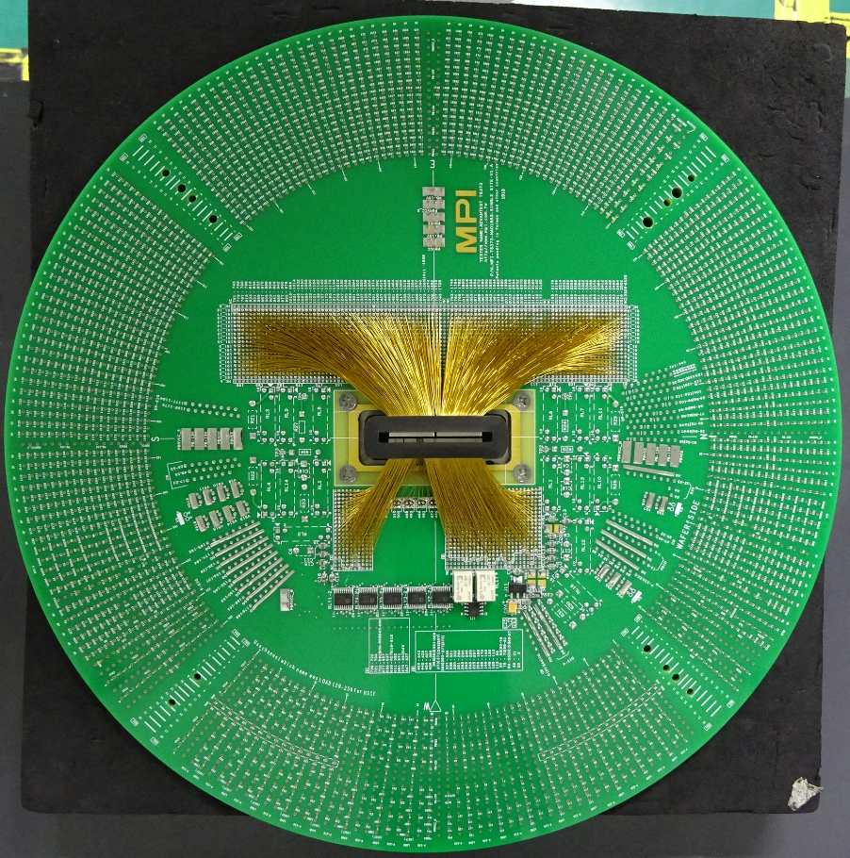
Porbe Card

Slide 15
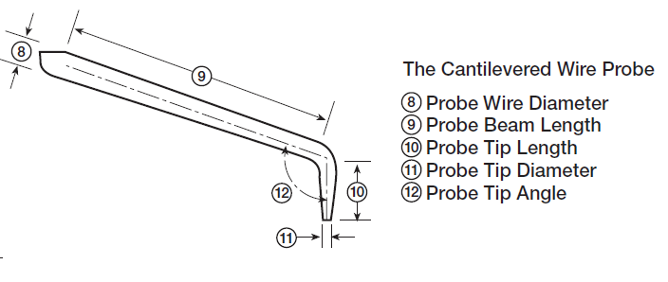
Probes (Cantilever)

Slide 16
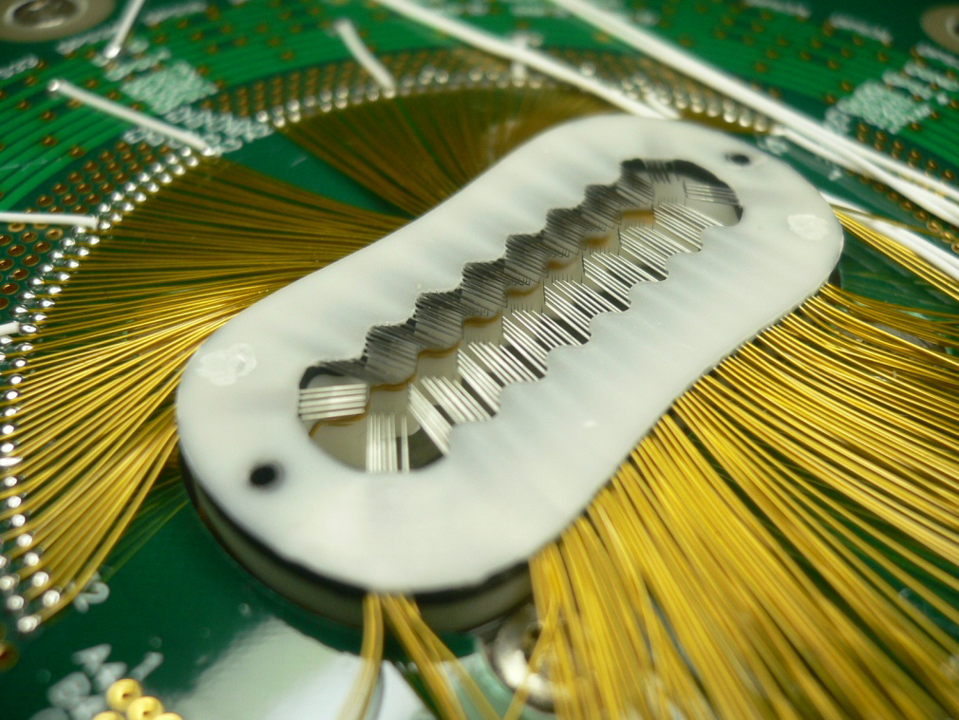
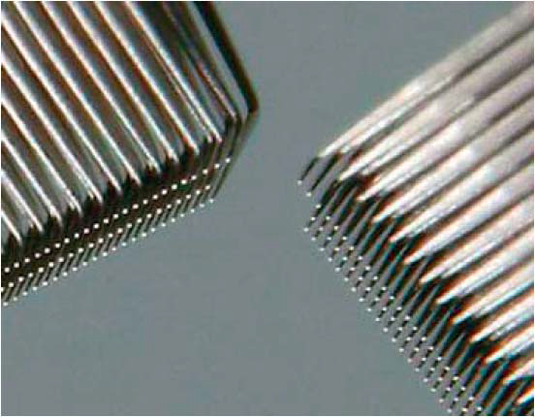
Probes (Cantilevered)

Slide 17
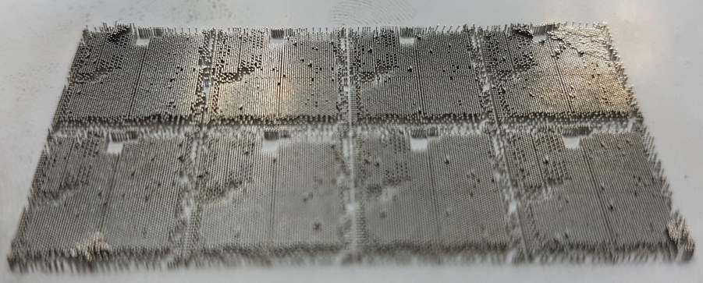
Probes (Vertical)

Slide 18
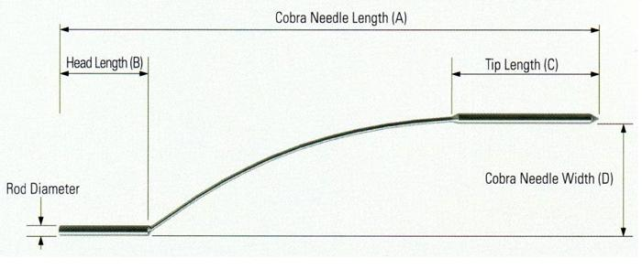
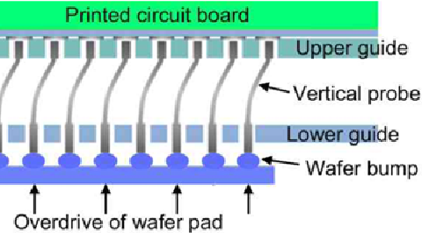
Probes (Cobra Probe)

Slide 19
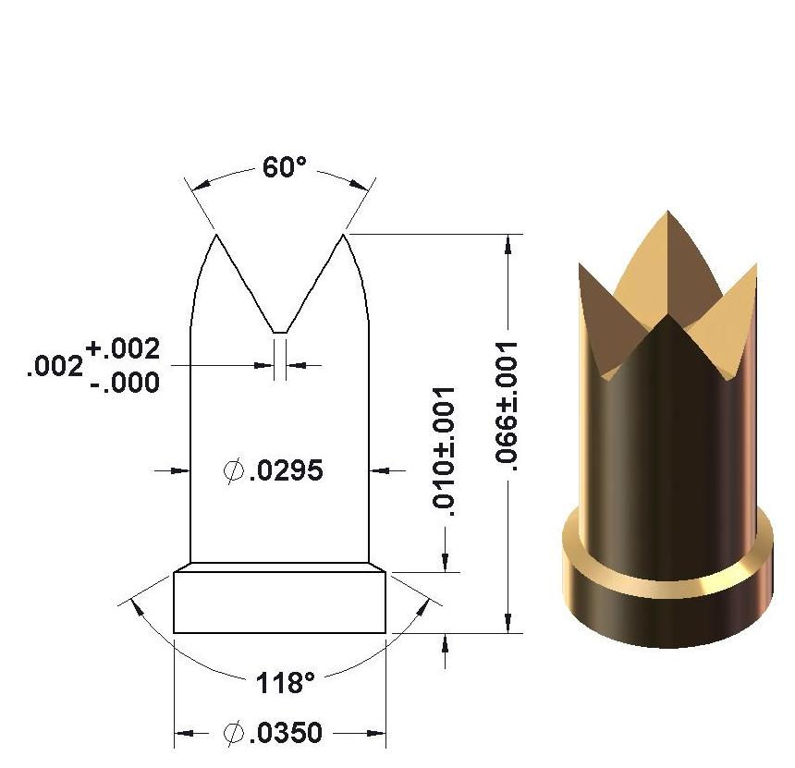
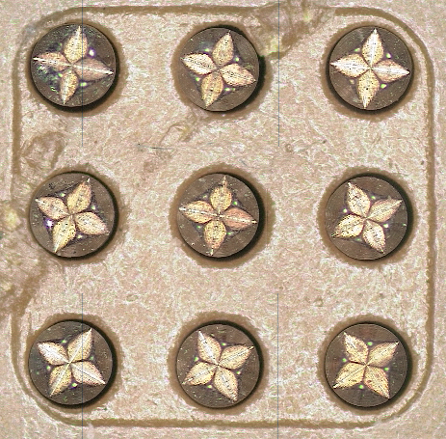
Probes (Spring contact probe: Crown Probe)

Slide 20
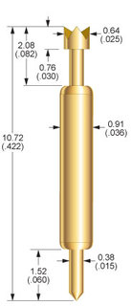
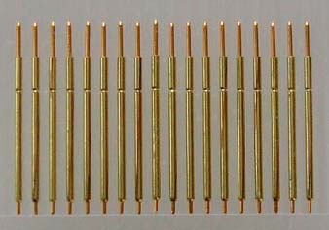
Probes (Spring contact probe: Crown Probe)

Slide 21
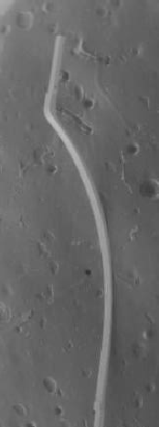
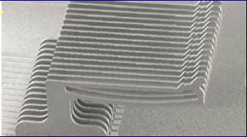
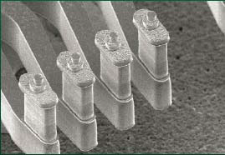
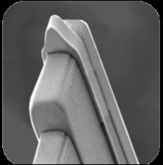
Probes MEMS (Microelectromechanical Systems)
Cantilever
Torsional
MicroProbe
Microfabrica
Notes:
1-100 um

Slide 22
Bend Angle
The bend angle, which is expressed in degrees, is the inside angle of the probe after bending. The probe card designer chooses this value. The angle used will determine the quality of the scrub mark the probe tip produces on the bond pad.
Probe Wire Diameter
Wire diameter has the most significant effect on contact force and pad pitch. It’s usually expressed in mils (= 0.001 inch = 25.4 micrometers).
Notes:
針尖角度
針身直徑

Slide 23
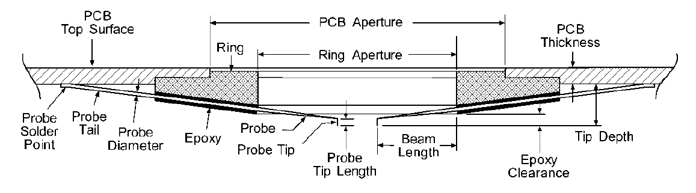
Notes:
針尖角度
針身直徑

Slide 24
Tip Diameter
Probe tip diameter affects the contact resistance of the tip and damage to the bond pad. Larger tip diameters have lower resistance; however, for applications with aluminum pads, the larger tips require greater probe force to break through the pad oxide layer. Tip diameter selection is based on the size and material of the bond pad and is expressed in mils
mils = 0.001 inch = 25.4 micrometers
Notes:
針尖直徑

Slide 25
Notes:
針尖直徑

Slide 26
PCB: Printed Circuit Board
Tip Length
Probe tip length is measured from the tip of the probe to the bend in the probe and is expressed in mils.
Probe Tip Depth
Tip depth is a critical parameter for prober setup. It’s the distance from the probe card’s reference plane to the plane formed by the probe tips, generally measured from the bottom of the PCB to the probe tip.
mils = 0.001 inch = 25.4 micrometers
Notes:
針長
針尖高度

Slide 27
Notes:
針長
針尖高度

Slide 28
Beam Length
The beam length is dictated by the die size. On custom designs, the probe card designer chooses the beam length to meet contact force requirements. Beam length is expressed in mils (e.g., 200 mil beam length) and is measured horizontally from the center of the probe tip to the point at which the probe enters the epoxy (or for ceramic blades, the point the probe contacts the ceramic).
mils = 0.001 inch = 25.4 micrometers
Notes:
針臂長度

Slide 29
Notes:
針臂長度

Slide 30
Motivation
Long-term usage will wear down, bend, or contaminate the contact probes.
Therefore we aim to automatically check every probe on a probe card by laser scanning and computer program processing.
Notes:
磨耗 汙染
傳統用光學顯微鏡人工

Slide 31
Objectives
Using programming to visualize scanning data while computing probe’s attributes.
If there are any exceptions, will output the following values: (e.g. Cantilever probe card)
Notes:
目標

Slide 32
Coplanarity: The average difference to the average needle height.
共面度 - 以平均針高為中心,上下對分公差
Position Error: The difference between the correct value and the center of the best circle for the needle tips
針偏 - 針徑圓心與標準值的差異
Notes:
共面度 針高 針長

Slide 33
Needle Height: The total length from where the beam starts to tip to its needle point.
針高 - 針臂開始轉彎處至針尖頂部的距離
Diameter for Needle: The diameter of the needle base and also the needle tip.
針徑 - 探針頂部的直徑

Slide 34
Methods
Scanning Instrument Introduction
Program Language and Packages
Program Language: Python
Package One: Numpy
Package Two: Mayavi
Programming Approach

Slide 35
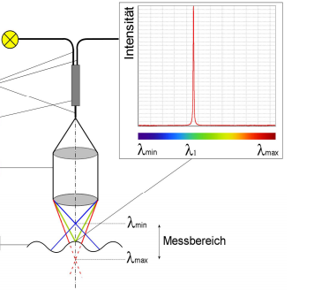
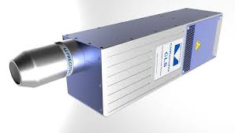
Scanning Instrument Introduction
PRECITEC
CHRocodile CLS
Chromatic Cofocal Line Sensor
192*2um

Slide 36

Program Language: Python
Could be run on most OS.
Easy-to-read and clean syntax.
Easy development.
Could be extend with different needs. eg. Scipy for scientific processing and Pillow for image processing

Slide 37
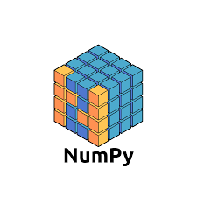
Package One: Numpy
For data input and storage
Core Function: n-dimensional array data structure.
High degree of dimensional array and matrix mass processing

Slide 38
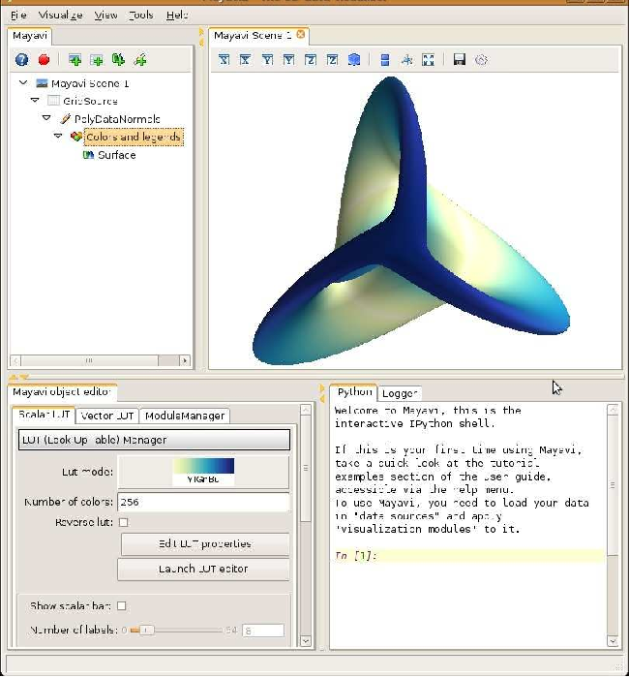
Package Two: Mayavi
An application could be called as a package by Python.
Have its own GUI.
Could present continuous, smooth 2D or 3D image.
GUI: Graphic User Interface

Slide 39
Computation Process
NG: No Good
Before every computation, the user has to input:
“correct value” and “tolerance value”.
In case of any exceptions (e.g. the tolerance value is ±8 um, and the correct value is 240 um. Everything out of the range of 232-248 um is accounted as exceptions.)
Every output will include:
“Maximum value”, “minimum value”, “average value”, and “NG needle/s”.

Slide 40
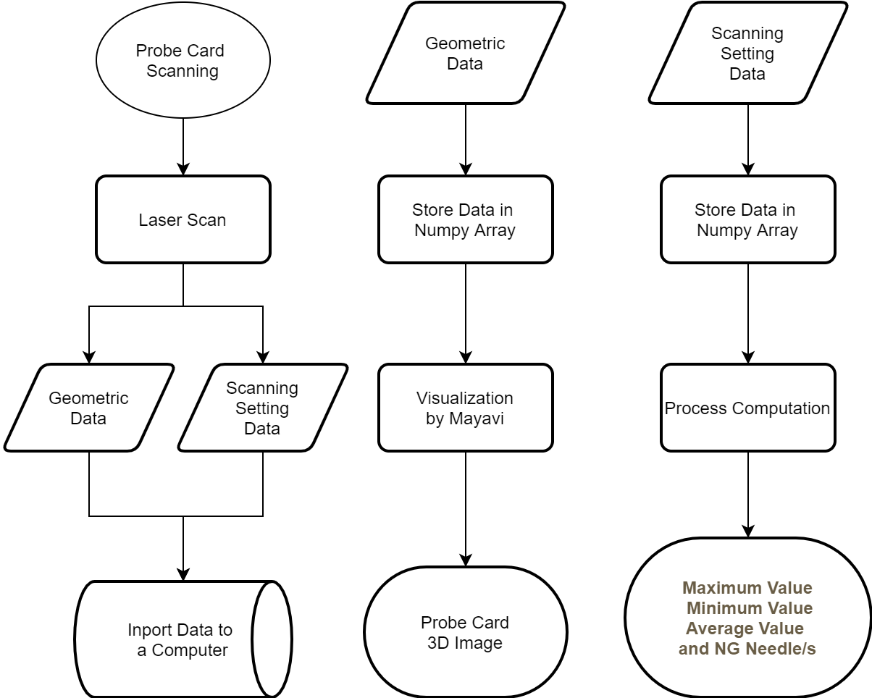
Computation
Process
input

Slide 41
Progress Reports
Data Visualization
Stability of Mayavi
MEMS probe card
Programming Language
Scanning Data and Storing Structure
Noise Reduction
Notes:
3/8不用

Slide 42
Data Visualization
Using visualization package Mayavi, we are able to visualize the scanning data
In this demonstration, here are crown pin probe card and catilever pin porbe card images
GUI: Graphic User Interface

Slide 43
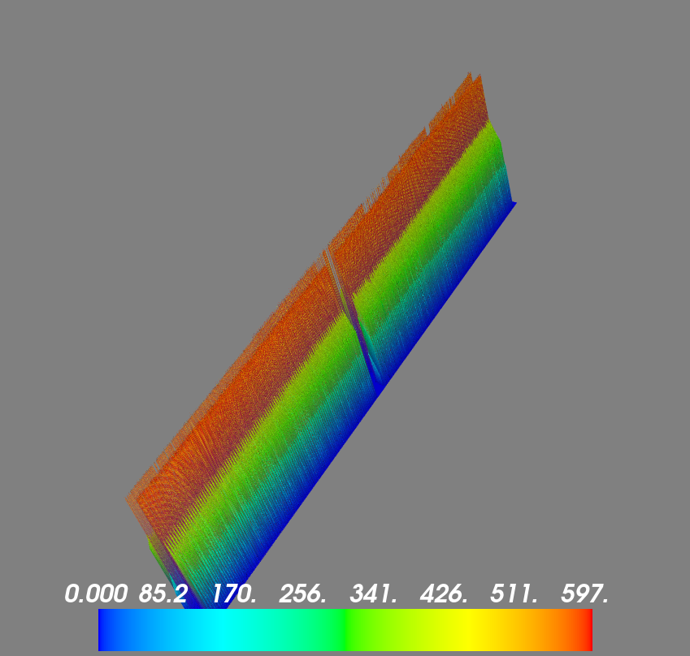
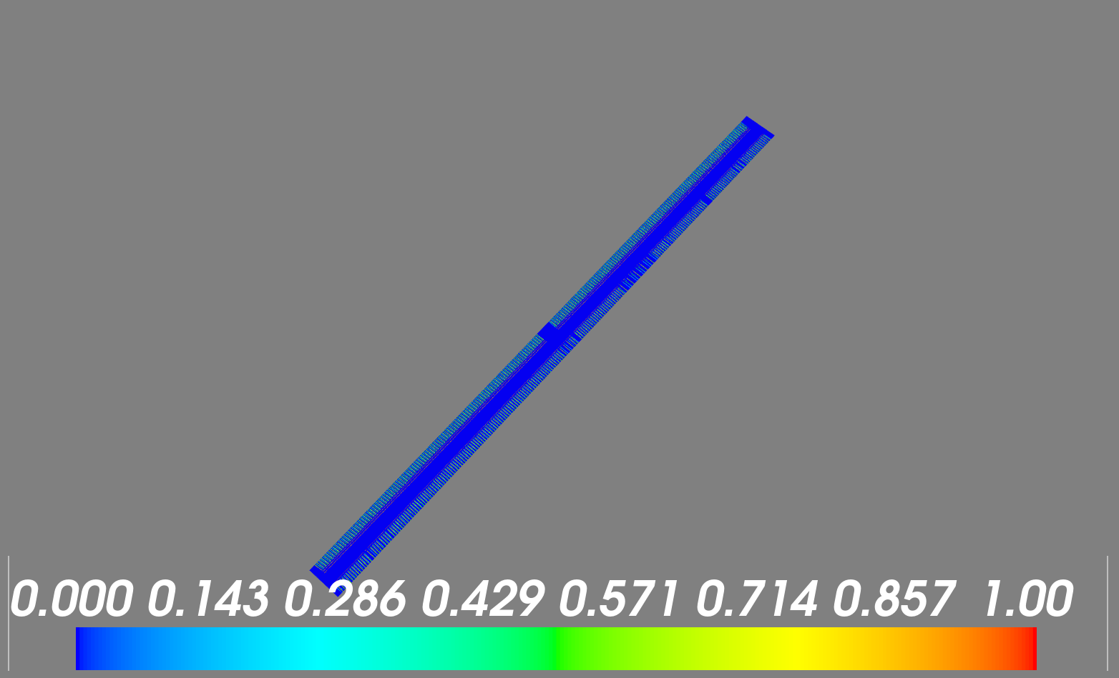
Altitude-Peak 1-CROWNpROBEcARD_1_th840
_5.00x4.68mm_5.00x5.00µm_1000Hz_94%_CLS02 4

Slide 44
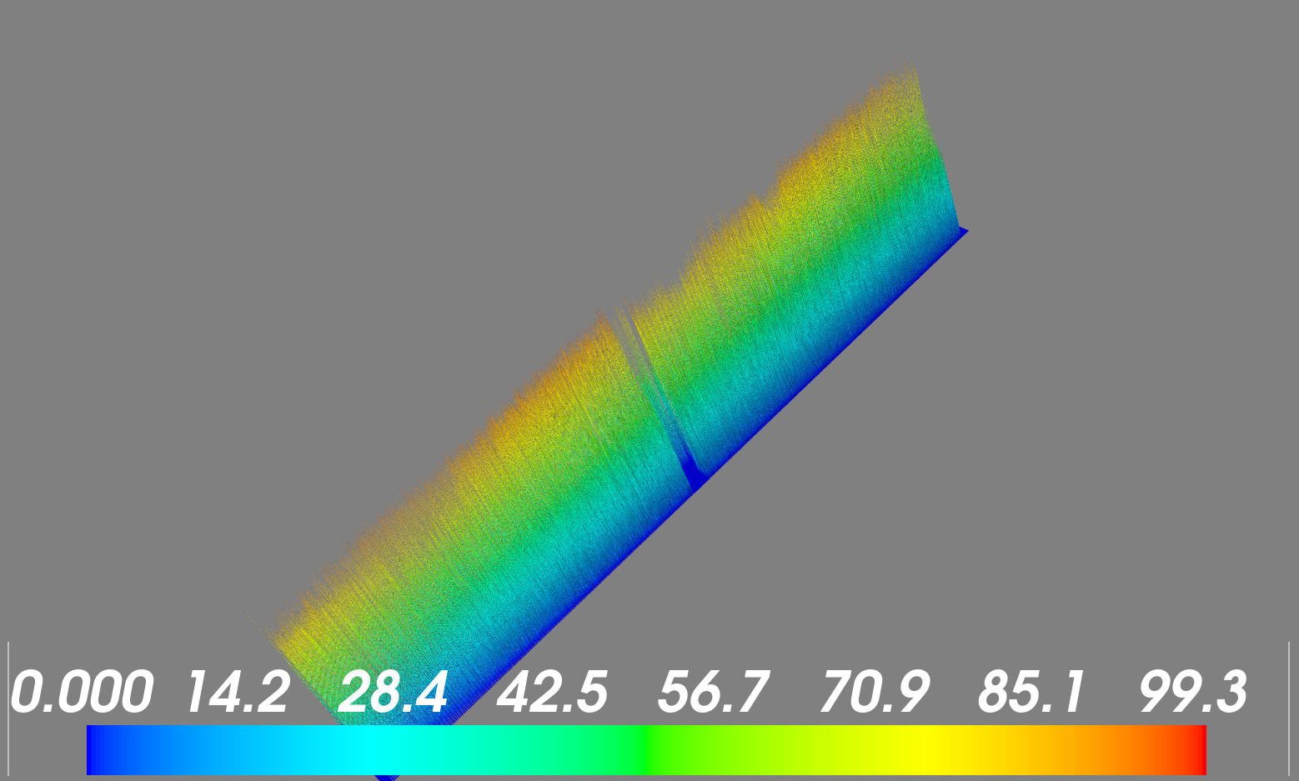
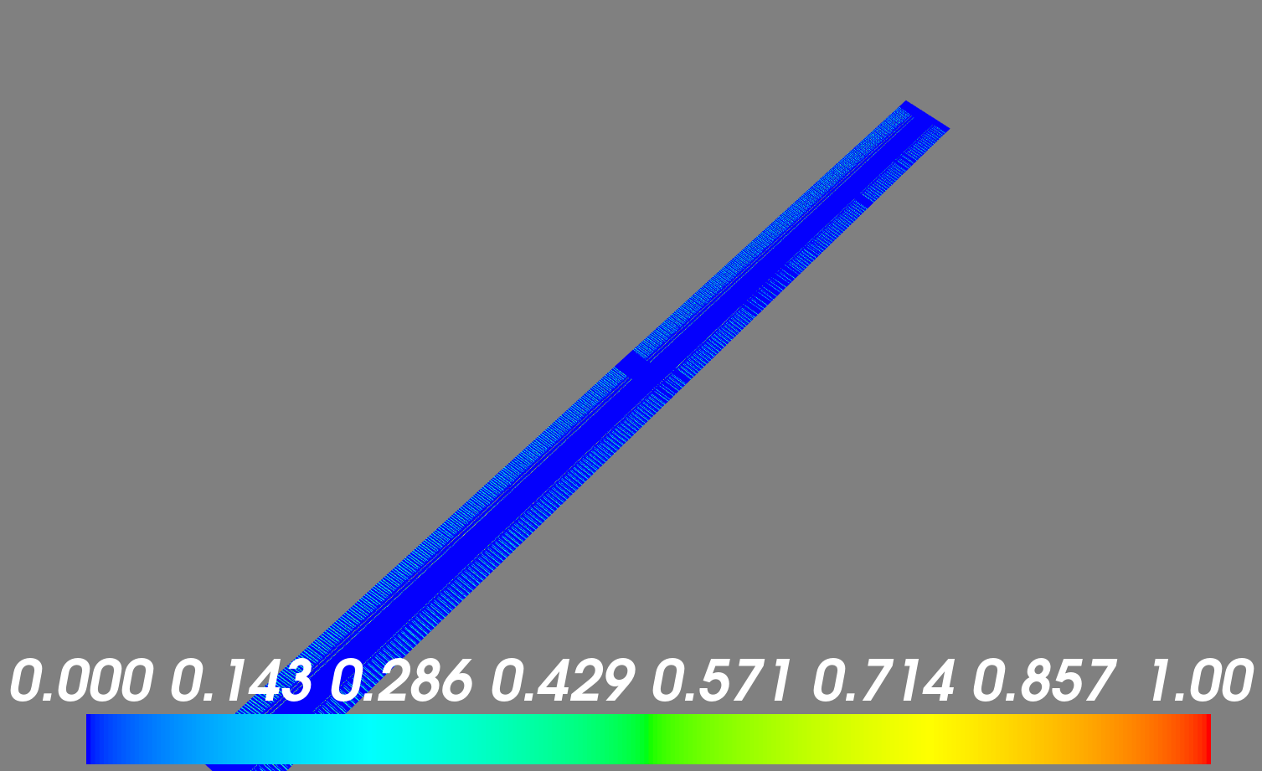
Intensity_Level-Peak 1-CROWNpROBEcARD_1_th840
_5.00x4.68mm_5.00x5.00µm_1000Hz_94%_CLS02 9

Slide 45
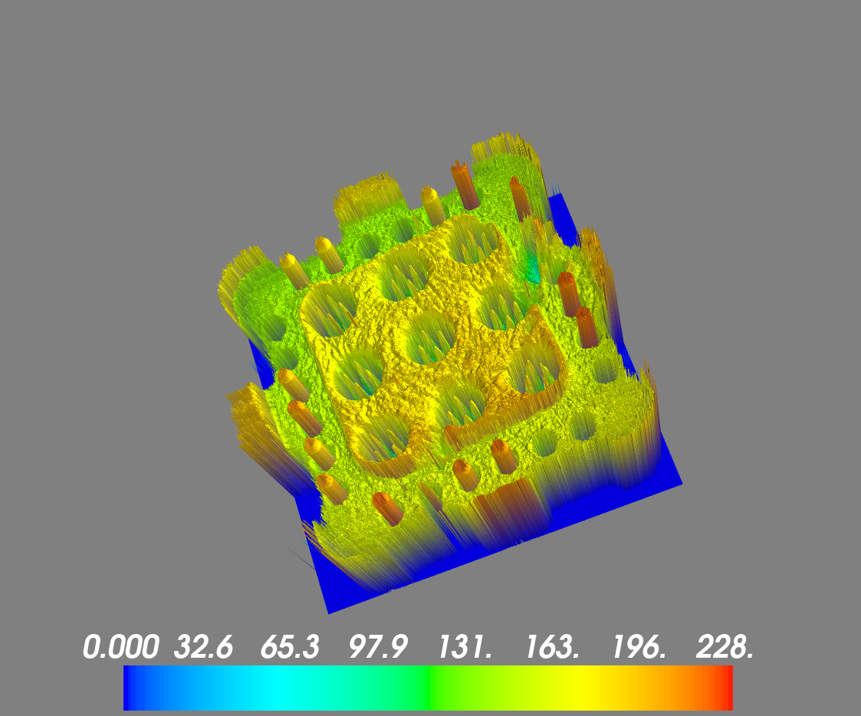
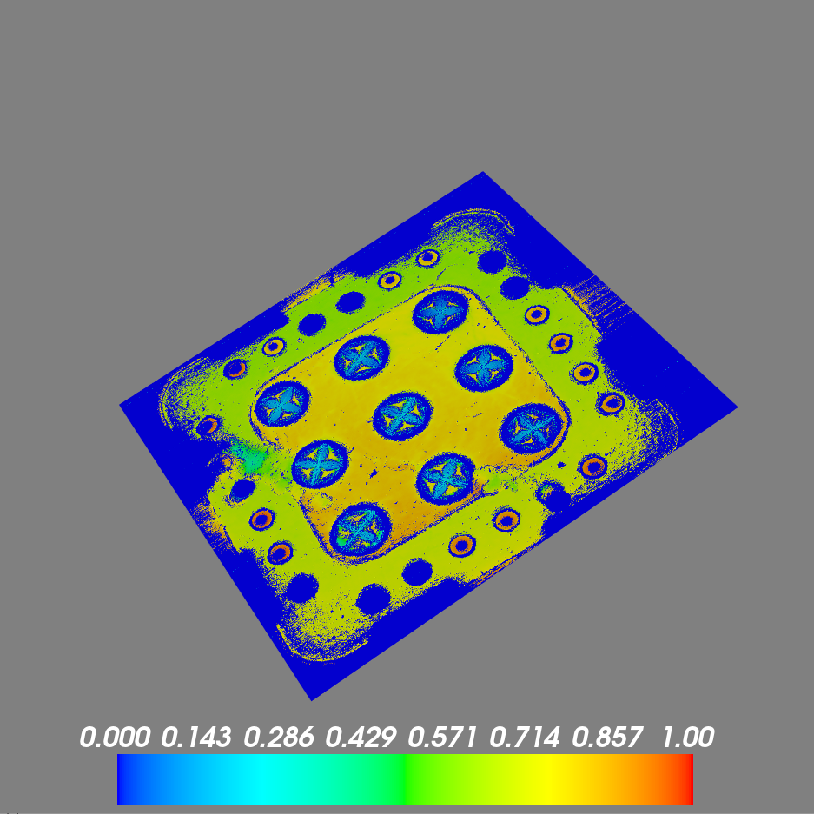
Altitude-Peak 1-pROBEcARD_1-1
_33.00x1.92mm_2.50x2.50µm_2000Hz_20%_CLS1 0

Slide 46
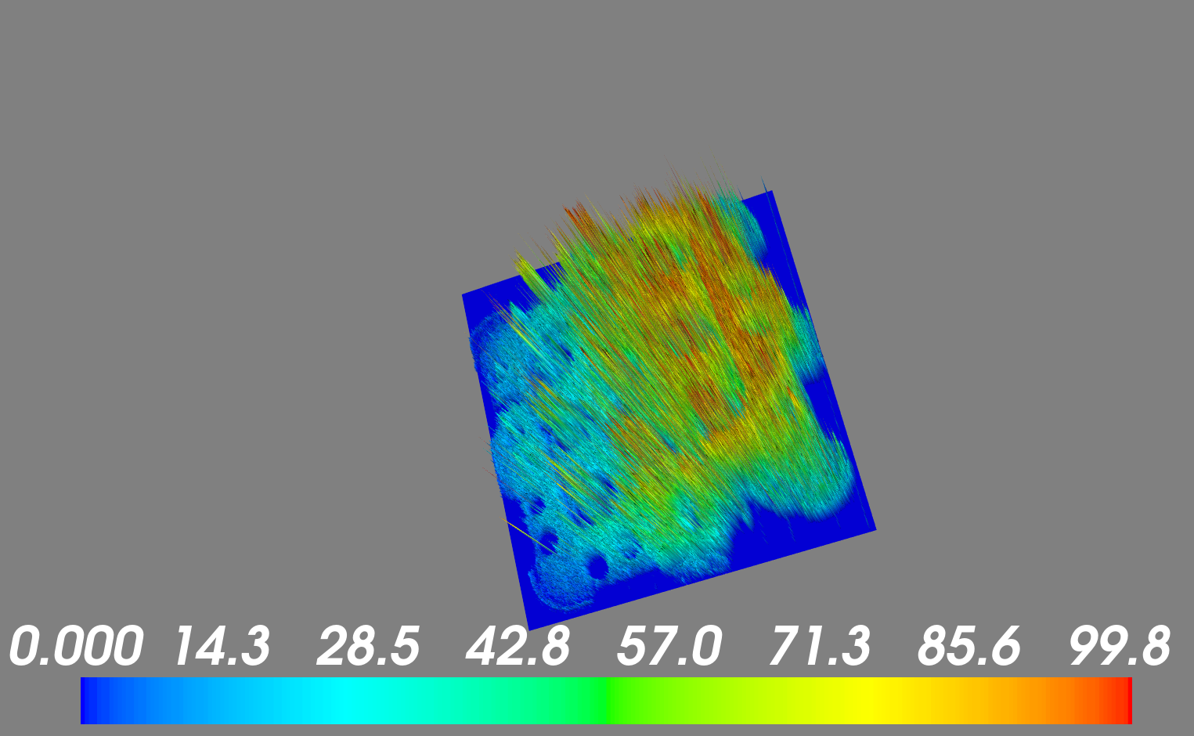
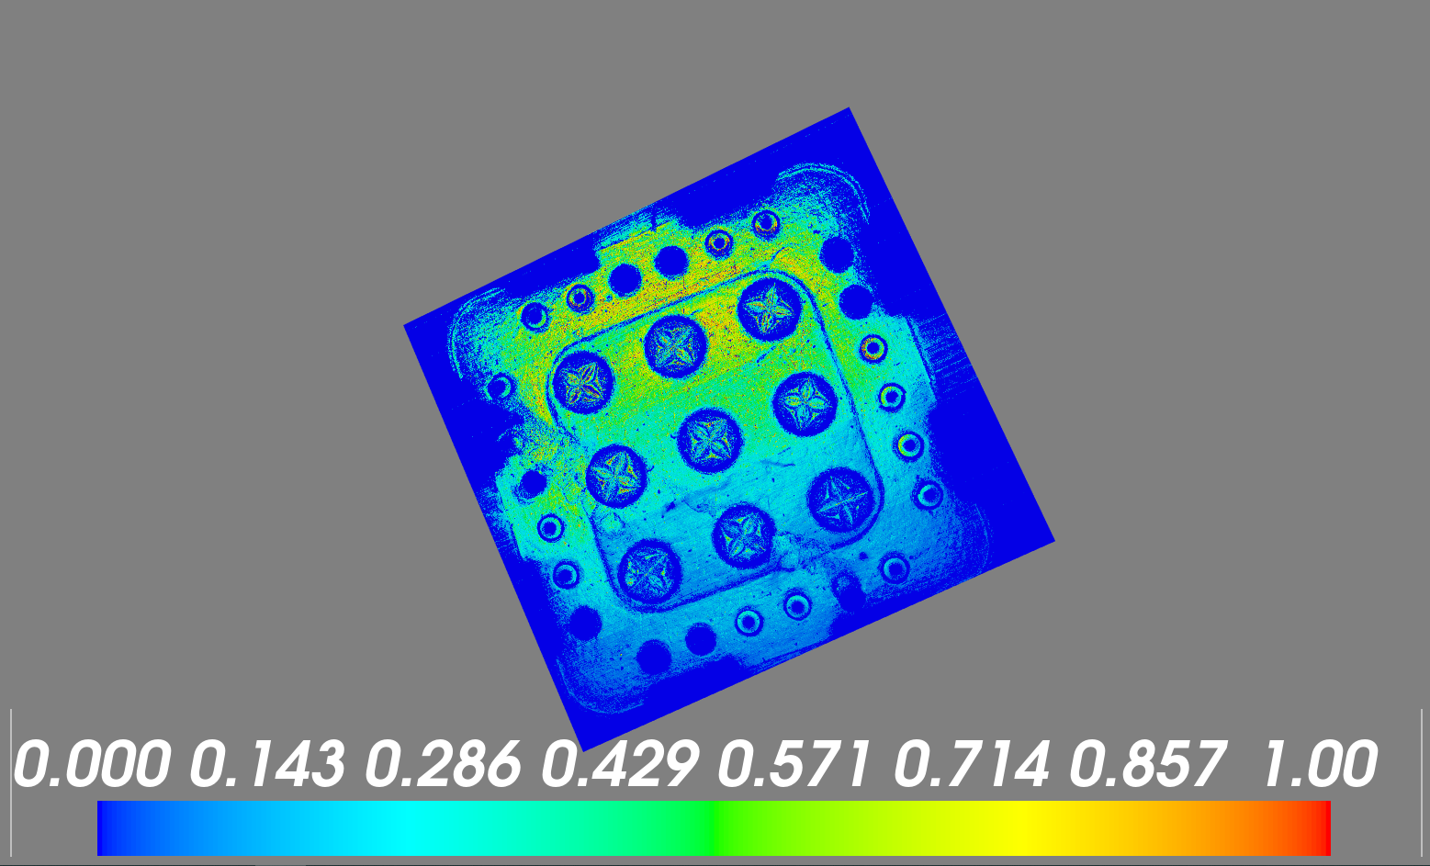
Intensity_Level-Peak 1-pROBEcARD_1-1
_33.00x1.92mm_2.50x2.50µm_2000Hz_20%_CLS1 5

Slide 47
Stability of Mayavi Performance
“Memory Leakage” affects the visualization performance
Improve performance by programming
Solution:
mlab.clf()

Slide 48


Programming Language Changed
In order to speed up the performance and integrate the program into the testing machine.
We’ve changed to C++ for the main program language. As for Python now we use it for any experimental method.
Notes:
CCD 一般光

Slide 49
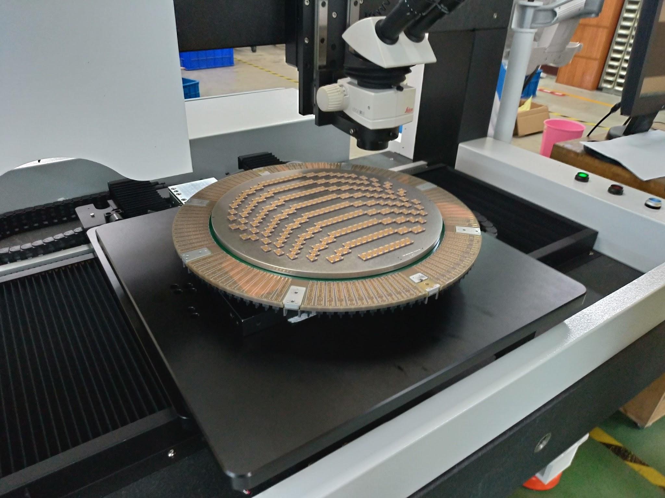
MEMS probe card
The new scanning data are MEMS vertical probe card.
Every cell has 59 MEMS vertical probes.
Notes:
59 根針/一個單位

Slide 50
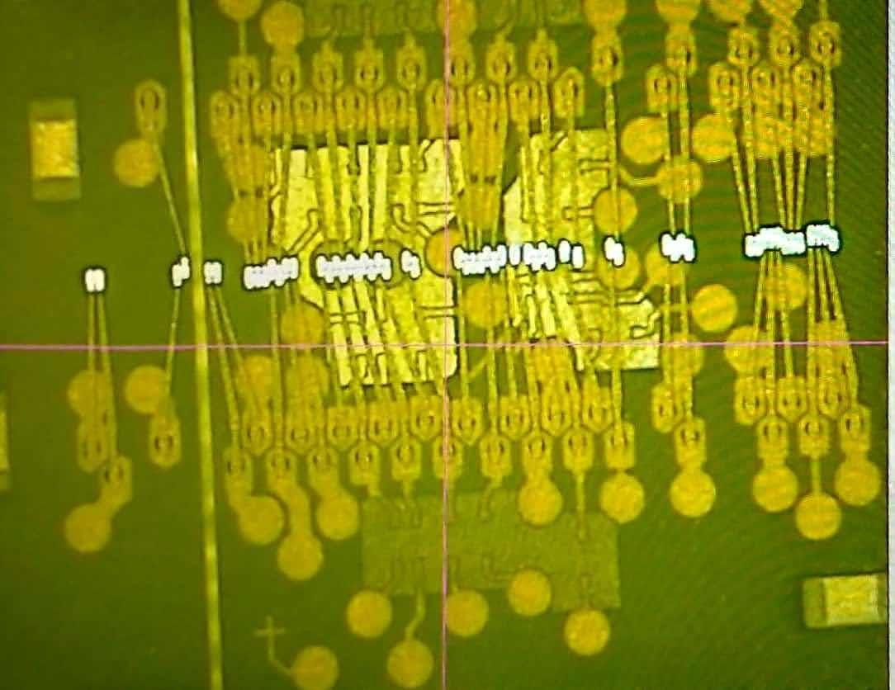
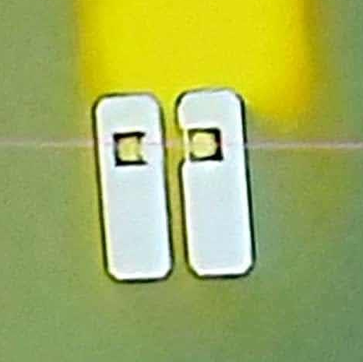
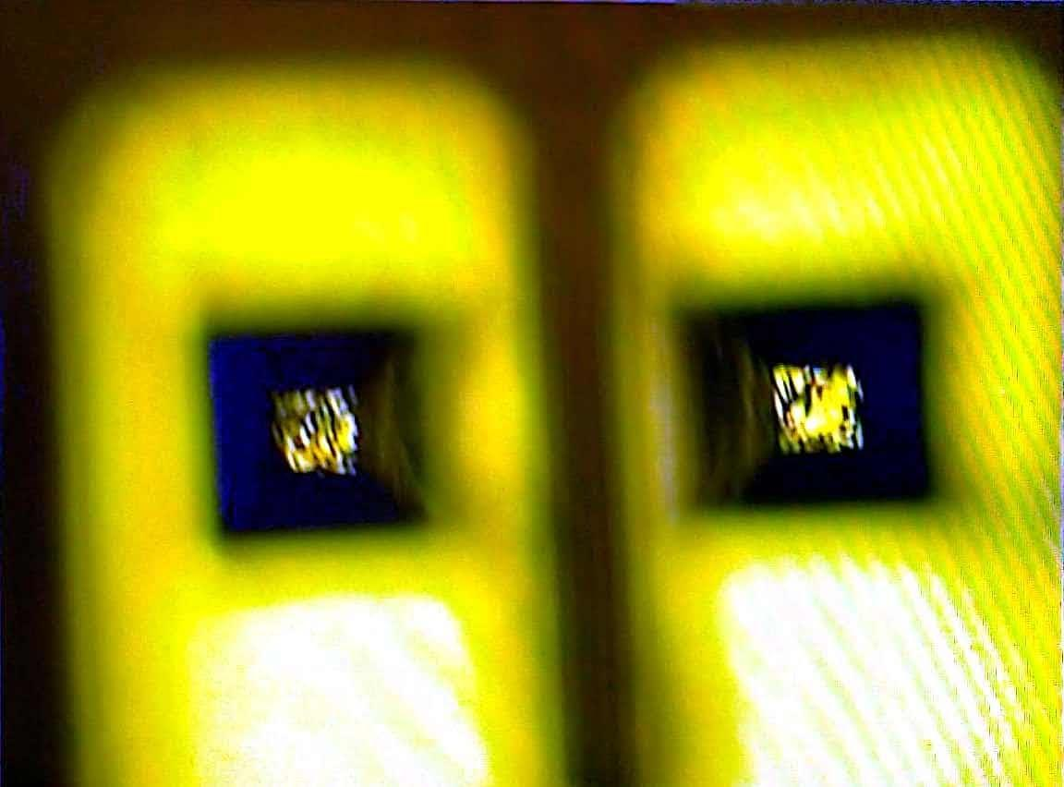
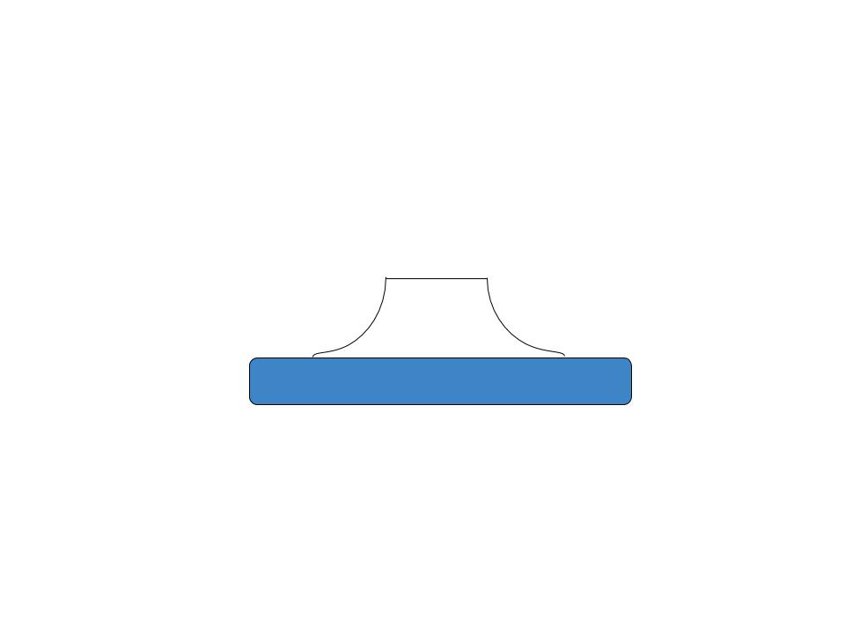

Slide 51
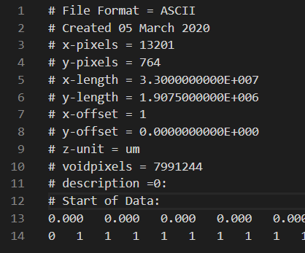
Scanning and Storing Data Structure
At first, the scanning data are retrieved by outsourced company.
Data are stored in ASCII form of .txt file
ASCII: American Standard Code for International Interchange

Slide 52
Scanning and Storing Data Structure
To accelerate performance of both analyzing and machine pipeline
Now the every pixel's information is stored independently, and it's stored in binary form of continuous stream, in a .dat file.
X | Y | Z | Intensity
(double)
(double)
(double)

Slide 53
Noise Reduction and Segmentation
The image has certain noise
Physical Contamination or Defect
Batman Effect
Height/Intensity Comparison
Our own Otsu's Threshhold Method

Slide 54
Original Output Image

Slide 55




Noise Reduction + Segmentation

Slide 56
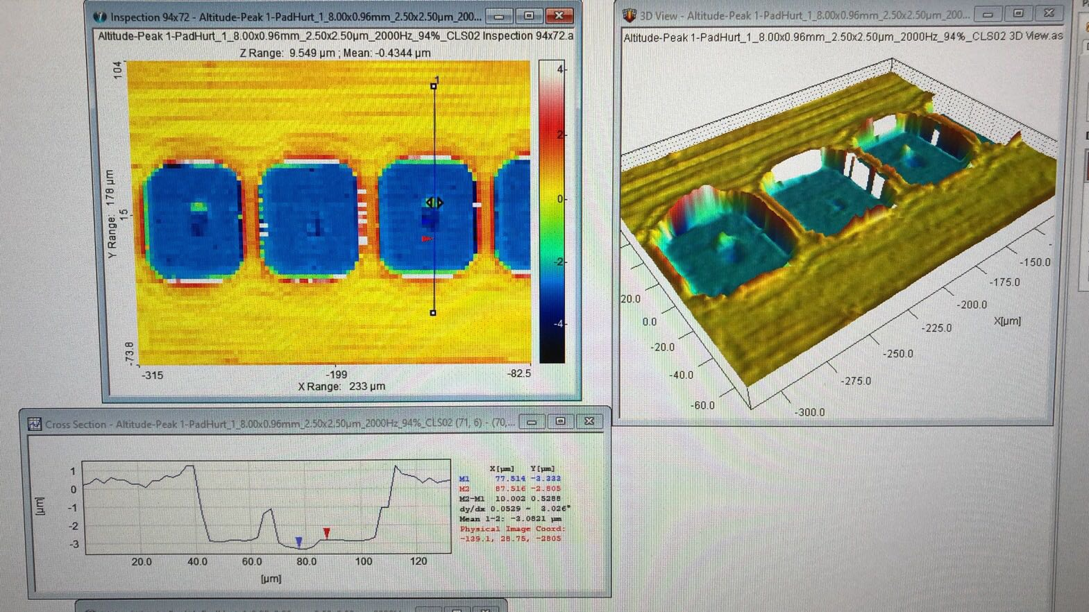
Future Goals
Noise Reduction
GUI Design
GUI: Graphic User Interface

Slide 57
References
[1] I. Feldman, “Wafer Probe Technology & Application Overview,” http://svtest.com/docs/TM-6%20Probe%20Technology&%20Application%20Overview-Ira%20Feldman.pdf, 2010.
[2] Precitic , “Optical Sensor CHRocodile Manual,”
http://img.jdzj.com/UserDocument/2015b/yahu19/Document/20151105120428.pdf, 2009.

Slide 58
[3]W.Mann, ““Leading Edge” Of Wafer Level Testing,”
https://www.swtest.org/swtw_library/2004proc/PDF/T00_01_Mann.pdf , 2004.
[4] O. Weeden, “Probe Card Tutorial,”
www.tek.com/dl/Probe_Card_Tutorial_WP.pdf, 2020.

Slide 59
Thank You for
Listening
這裡反白絕對什麼都沒有
動機：探針卡的維護需要透過人力使用光學顯微鏡來檢測，耗時且不客觀
目標：將探針卡的檢測透過掃描與程式設計自動化
方法：透過全光譜共焦線性掃描器掃描出的座標、高度、光強度之地理資訊，透過標準檔與忍受值，計算出掃描物是否符合要求。並且利用Mayavi套件來成像。

